Slide 1
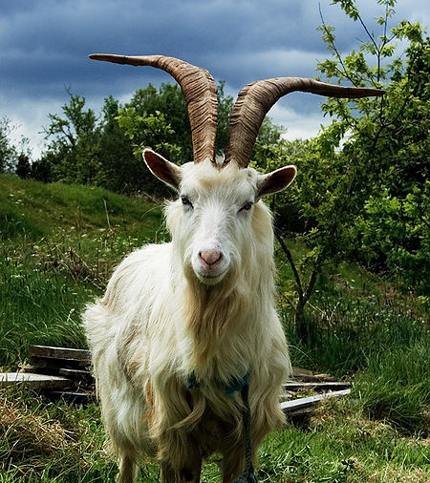
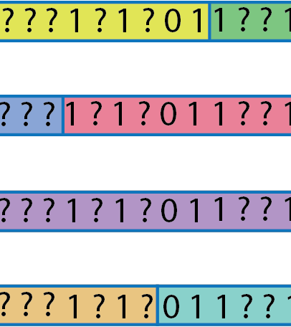
Phasing and Imputation of 1,372 Diverse Goat Whole Genome Sequence Data : Optimal Strategies
VarGoats WG12 Imputation
Notes:
Hello, today I am going to talk about phasing and imputation of 1,372 Goat WGS data; how we are using this data for developing phasing and imputation pipeline, with the goal of using this data for GWAS fine mapping, meta-analysis and genomic prediction. I am not going to discuss much background on imputation as we all in this group know about it and we also discussed about it in earlier meetings.

Slide 2
Objectives of the study
The objective of the study is to develop imputation pipeline from diverse whole genome sequence (WGS) goat population data which will be used in fine mapping, meta-analysis, and genomic prediction
Notes:
As I discussed earlier the objective….all the different continents and breeds

Slide 3
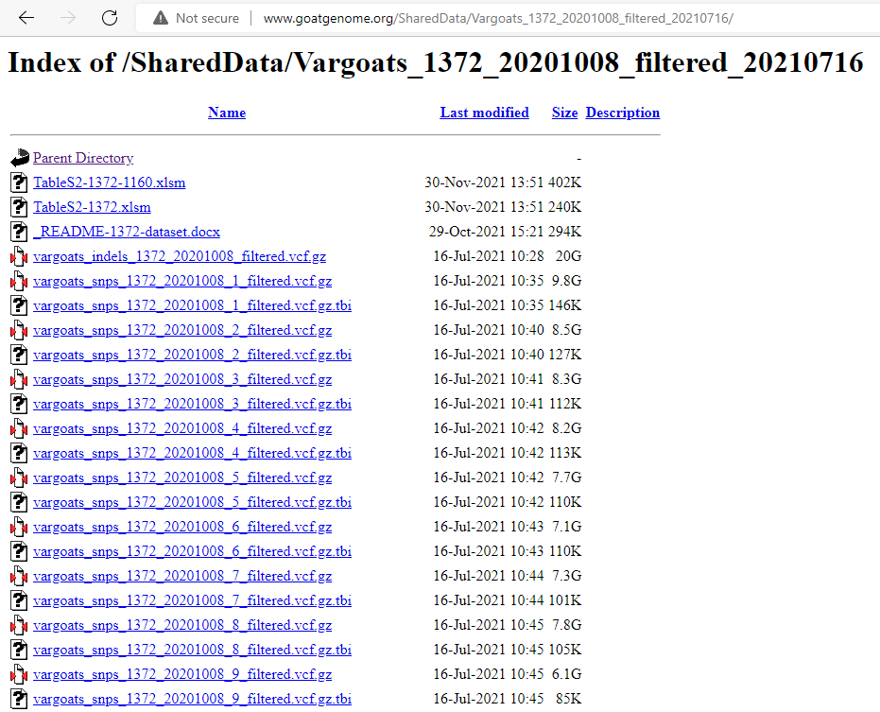
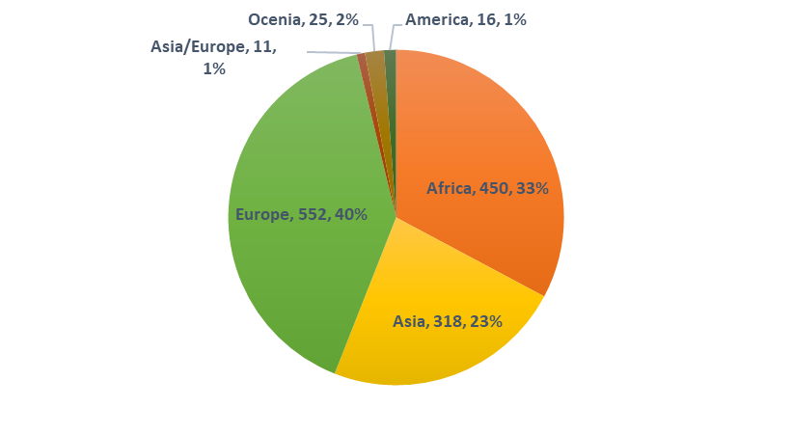
Study population (1,372 WGS samples)
Notes:
Earlier we have more Asian and eruopean samples 1159
Qc filtered data

Slide 4
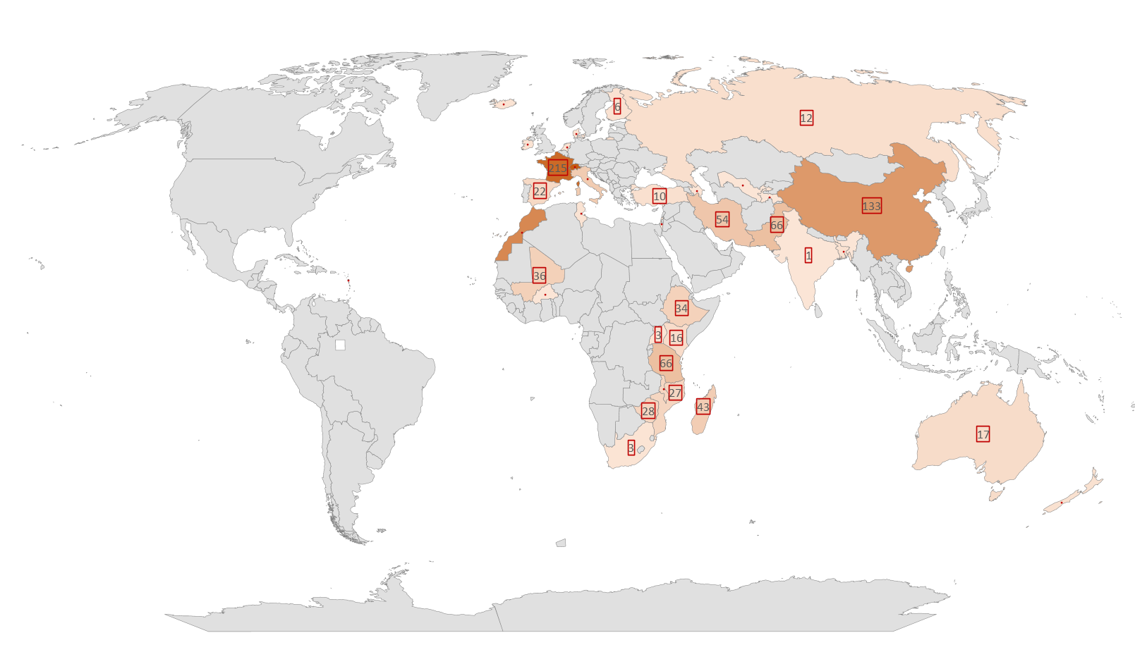
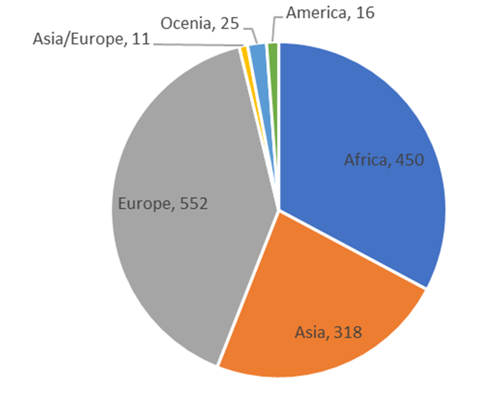
Geographical distribution of samples
Country | Number
Switzerland | 242
France | 215
Morocco | 163
China | 133
Pakistan | 66
Tanzania | 66
Iran | 54
Notes:
38 countries

Slide 5
Breeds
115 breeds
Saanen | 93
Alpine | 91
JiningGrey Goat | 40
Angora | 34
Boer | 34
Korea Native Goat | 27
Grisons striped | 25
Valais Goat (Blacknecked) | 25
Appenzell | 24
Booted Goat | 24
Nera Verzasca | 24
Peacock | 24
Toggenburger | 24
Notes:
The qc filtered vcf files from VarGoat new WGS data set was used for this analysis.
This data set has increase in Asian and European samples from last data set of 1,159 animals.

Slide 6
Phasing and Imputation
Phasing and imputation with Beagle 5.3
Reference sequence (vcf format) – haplotype phasing – Hidden Markov method-Baum algorithm
The Beagle 5.3 genotype phasing method is described in:
B L Browning, X Tian, Y Zhou, and S R Browning (2021) Fast two-stage phasing of large-scale sequence data. Am J Hum Genet 108(10):1880-1890. doi:10.1016/j.ajhg.2021.08.005
The Beagle 5.3 genotype imputation method is described in:
B L Browning, Y Zhou, and S R Browning (2018). A one-penny imputed genome from next generation reference panels. Am J Hum Genet 103(3):338-348. doi:10.1016/j.ajhg.2018.07.015

Slide 7
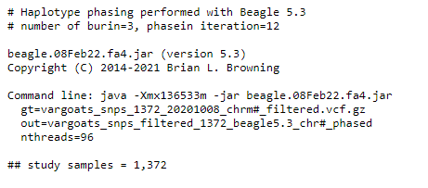
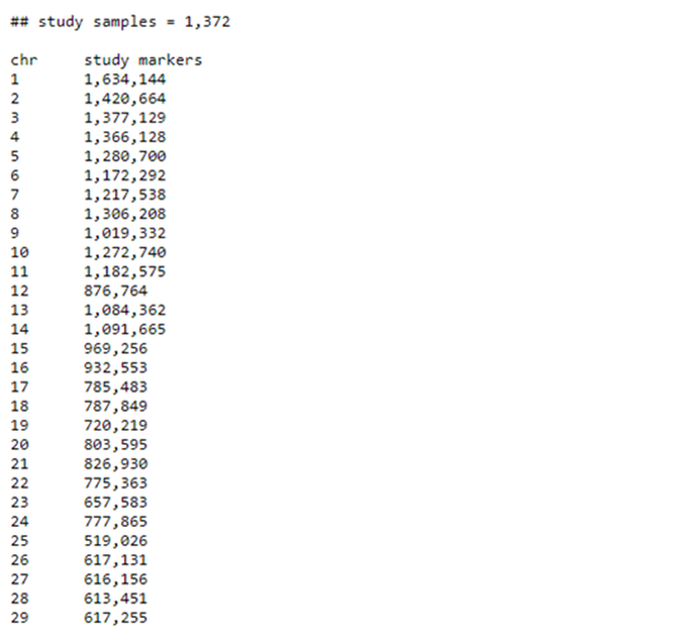
Phasing
Standard parameters are used in Beagle version 5.3
Analysis was done using high performance computing cluster at USDA-ARS
Computational time Chr1
Burin iteration: 20 minutes 17 seconds
Haplotype phasing time: 1 hr 2 minutes 0 seconds

Slide 8
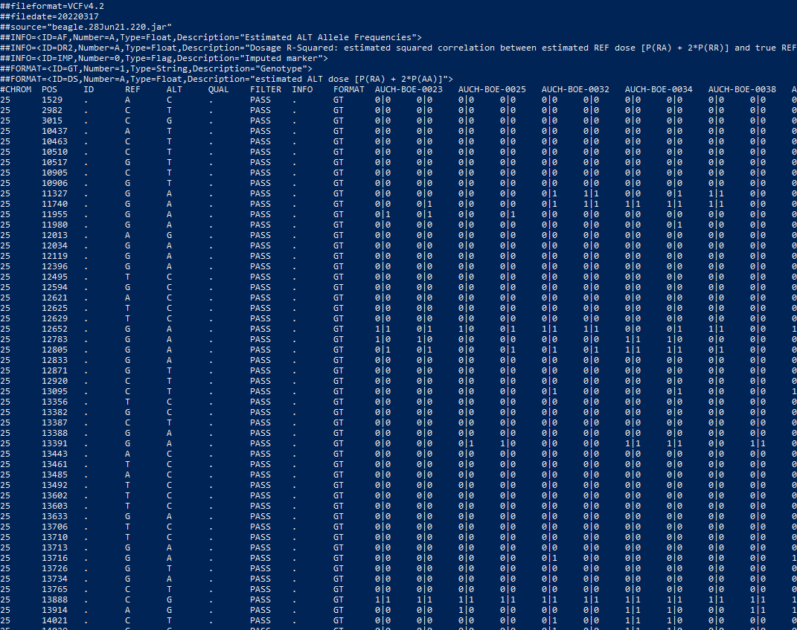
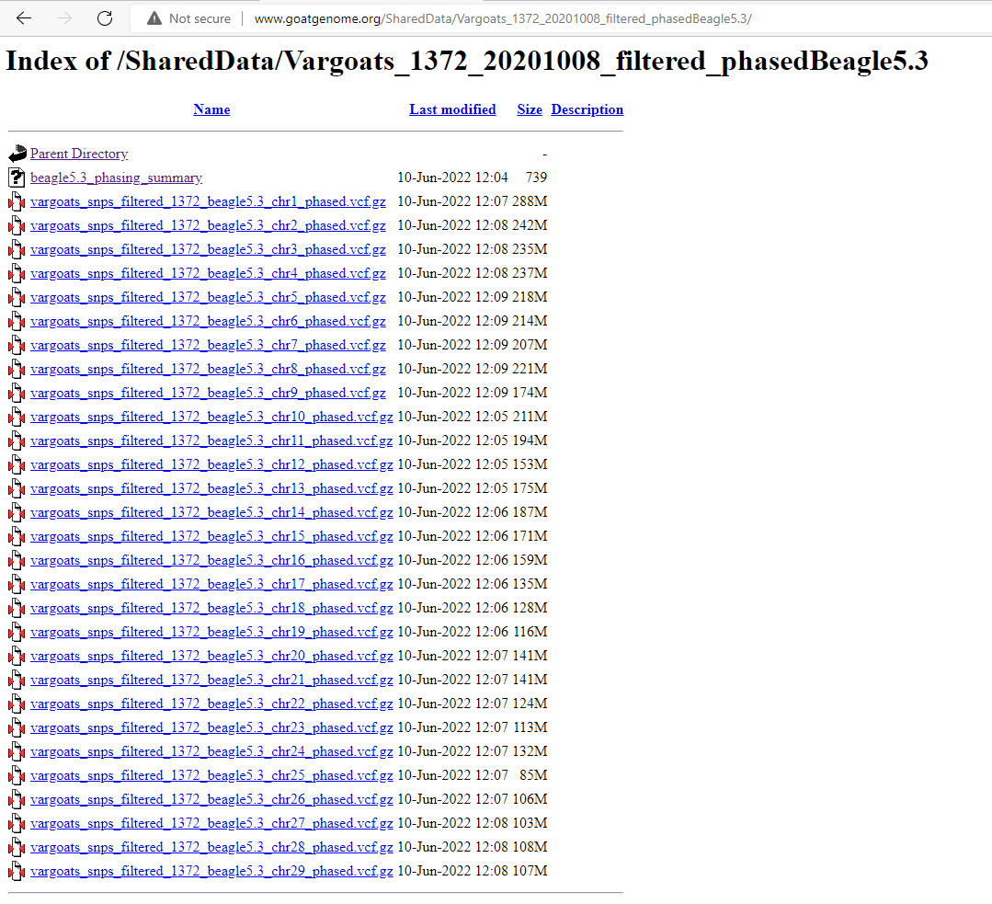
Phasing results

Slide 9
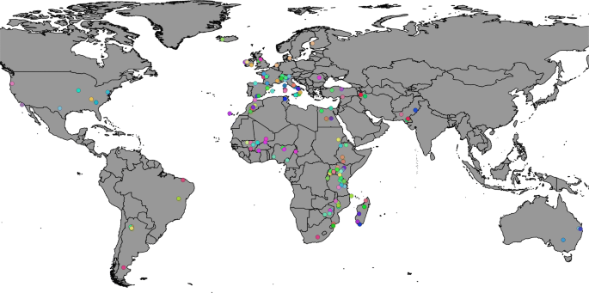
Imputation (50K to WGS) running
3,197 animals with 46,654 autosomal markers
Same QC filtered data set was used as in Colli et al. 2018 (Genome-wide SNP profiling of worldwide goat populations…)
Analysis:
Single region reference (African) to African samples and
all region data to all samples
Colli et al., Genet Sel Evol 50, 58 (2018)
Notes:
Colli, L., Milanesi, M., Talenti, A. et al. Genome-wide SNP profiling of worldwide goat populations reveals strong partitioning of diversity and highlights post-domestication migration routes. Genet Sel Evol 50, 58 (2018). https://doi.org/10.1186/s12711-018-0422-x

Slide 10
Accuracy estimation
Leave one out cross validation of 30 random samples (reduced to 50K and imputed back to WGS)
r² : Can estimate when true genotypes are unknown (AGHJ 69:1-14)
Accuracy of imputation will also be accessed based on MAF to determine the accuracy for low frequency variants and at the chromosome level

Slide 11
Next step
Accuracy and speed of imputation will be accessed from 50K SNP marker panel to whole genome level
Imputation accuracy will be accessed based on single/major breed/closely related breed vs multibreed and region-specific vs all regions
Comparison between Beagle and other programs if needed

Slide 12
Future work
Pipeline and scripts on GitHub repository
GWAS fine mapping, meta-analysis, and genomic prediction
Additional samples will be helpful in imputation of breeds currently underrepresented in the analysis
Incorporation of pedigree/family information will be useful for long-range haplotype-based imputation using findhap.f90.
Notes:
This approach is currently used in US genomic evaluation in dairy cattle.

Slide 13


Acknowledgements
Vargoat Imputation discussion group
Ben and Curt
SCINET Ceres Scientific computing (https://scinet.usda.gov)
Notes:
High performance computing

Slide 14
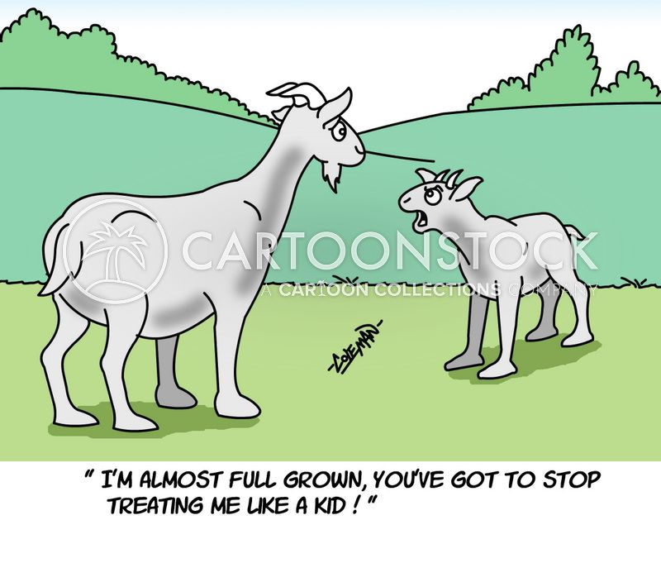
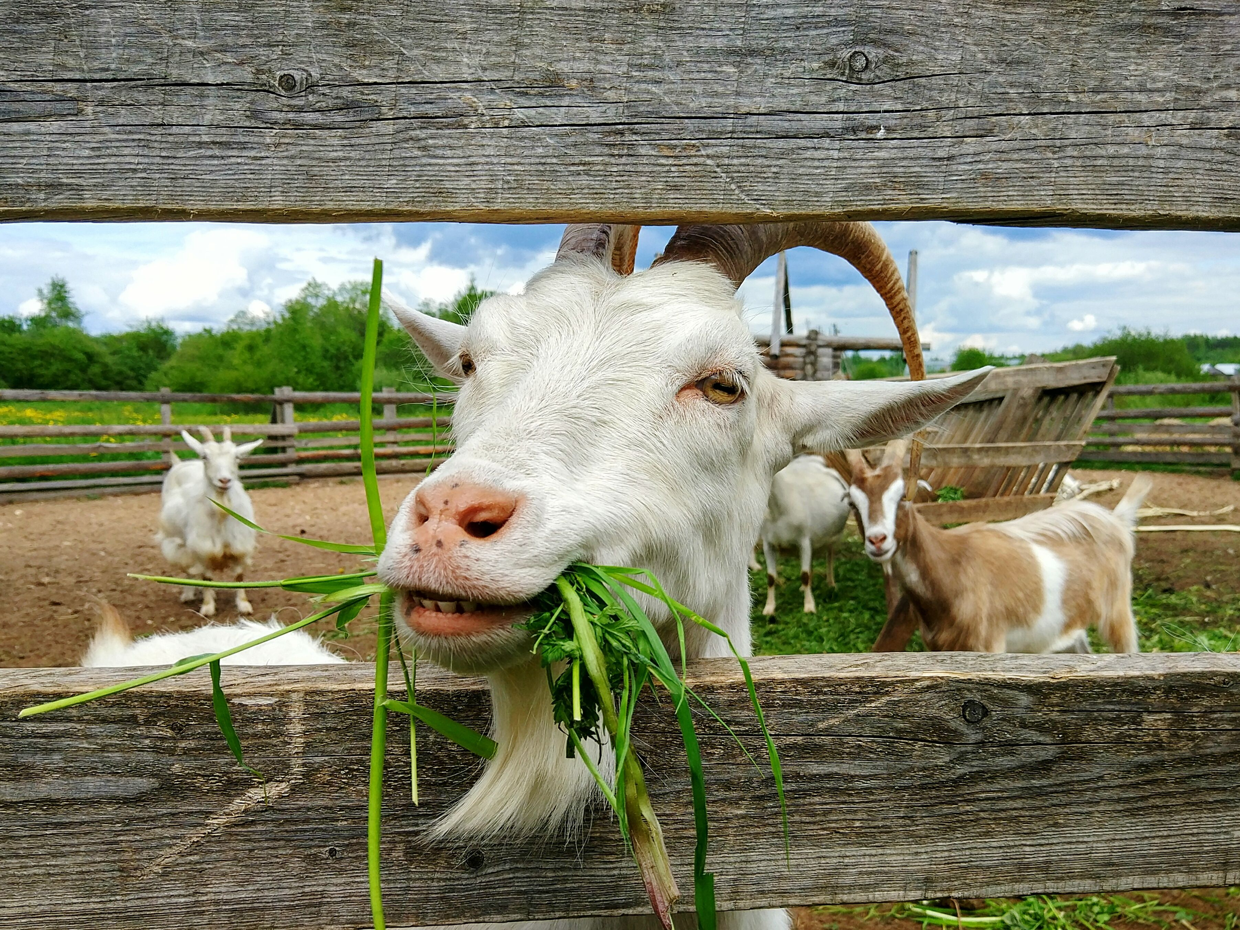
Questions/Comments/Discussion

